Slide 1
Overview
The human brain computes in an entirely different way from the conventional digital computer.
The brain routinely accomplishes perceptual recognition in approximately 100-200ms.
How does a human brain do it?

Slide 2
What precisely is a Neural Network??

Slide 3
How do our brains work?

Slide 4
How do our brains work?
A neuron has
A branching input (dendrites)
A branching output (the axon)
The information circulates from the dendrites to the axon via the cell body
Axon connects to dendrites via synapses
Synapses vary in strength

Slide 5
Axons = the transmission lines
Dendrites = the receptive zones
Action potentials, spikes originate at the cell body of neurons and then propagate across the individual neurons at constant velocity and amplitude.
Synapses are elementary structural and functional units that mediate the interactions between neurons.
Excitation or inhibition

Slide 6
How do our brains work?
A neuron is connected to other neurons through about 10,000 synapses
A neuron receives input from other neurons. Inputs are combined.
Once input exceeds a critical level, the neuron discharges a spike an electrical pulse that travels from the body, down the axon, to the next neuron(s)
The axon endings almost touch the dendrites or cell body of the next neuron
Transmission of an electrical signal from one neuron to the next is effected by neurotransmitters.
Neurotransmitters are chemicals which are released from the first neuron and which bind to the second neuron.
This link is called a synapse. The strength of the signal that reaches the next neuron depends on factors such as the amount of neurotransmitter available.

Slide 7
Definition
A neural network is a massive parallel distributed processor made up of simple processing units, which has a natural propensity for storing experimental knowledge and making it available for use. It resembles the brain in two respects:
1) Knowledge is acquired by the network from its environment through a learning process.
2) Interneuron connection strengths, known as synaptic weights, are used to store the acquired knowledge.

Slide 8
A Biological Neuron and its Mathematical Model

Slide 9
The Artificial Neuron

Slide 10
A model of a neuron:
Non linear Model of Neuron

Slide 11
Activation Functions

Slide 12
Activation Functions

Slide 13
Activation: Sigmoid

Slide 14
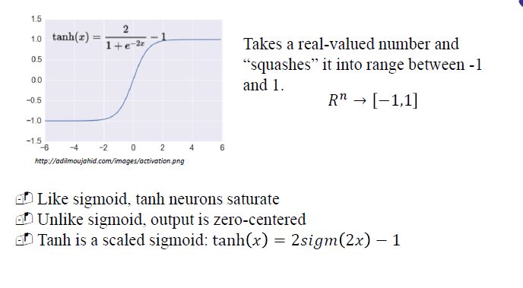
Activation: Tanh

Slide 15
Activation: ReLU

Slide 16
The REctified Linear Unit (ReLU)

Slide 17
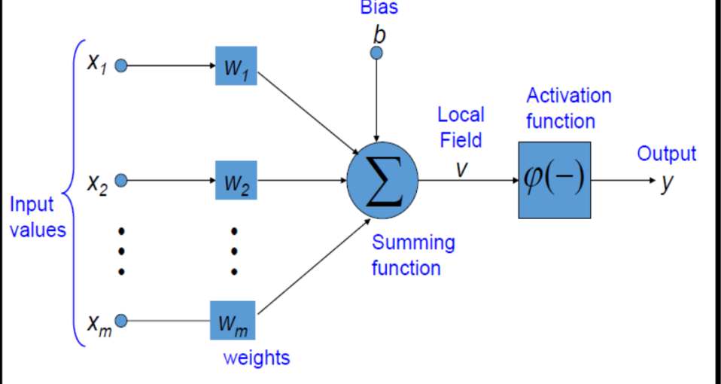
Neural Network Intro

Slide 18
Training

Slide 19
Loss functions and output

Slide 20
Multilayer Perceptron Architecture

Slide 22
How A Multi-Layer Neural Network Works?
The inputs to the network correspond to the attributes measured for each training tuple
Inputs are fed simultaneously into the units making up the input layer
They are then weighted and fed simultaneously to a hidden layer
The number of hidden layers is arbitrary, although usually only one
The weighted outputs of the last hidden layer are input to units making up the output layer, which emits the network's prediction
The network is feed-forward in that none of the weights cycles back to an input unit or to an output unit of a previous layer
From a statistical point of view, networks perform nonlinear regression: Given enough hidden units and enough training samples, they can closely approximate any function

Slide 23
Backpropagation
•Iteratively process a set of training tuples & compare the network's prediction with the actual known target value
•For each training tuple, the weights are modified to minimize the mean squared error between the network's prediction and the actual target value
•Modifications are made in the “backwards” direction: from the output layer, through each hidden layer down to the first hidden layer, hence “backpropagation”
•Steps
Initialize weights (to small random #s) and biases in the network
Propagate the inputs forward (by applying activation function)
Backpropagate the error (by updating weights and biases)
Terminating condition (when error is very small, etc.)

Slide 25
Gradient Descent

Slide 26
One forward pass

Slide 27
Regularization

Slide 29
Essential Tools
•Git andGithub
•Python
•JupyterNotebooks
•Numpy for Matrix and Vectorcalculations
•Pandas for Data handling, curation andmanipulation
•Matplotlib for plotting of graphs for different analysis ondata
•So many other Python APIs to make your life easy to develop DLmodels

Slide 30
What is an Image?

Slide 31
Digit Recognition

Slide 32
Image in 2 D Space

Slide 55
Convolutional Neural Network (CNN)?

Slide 56
The whole CNN

Slide 57
Max Pooling

Slide 58
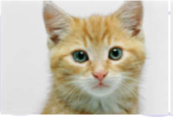

Slide 59


Slide 60
Why Pooling/Subsampling

Slide 61
A CNN compresses a fully connected network in two ways:

Slide 62
Dropout

Slide 63
Flattening

Slide 64
The spatial hyperparameters

Slide 65
The popular CNN

